Slide 1
Computer Breakdown
ECS 50

Slide 2
Major Components
Hardware
Execute the computer's commands
CPU, Memory, Hard Drive, Ethernet Card, Monitor, Keyboard, ...
Low Level Software
Operating system
System calls

Slide 3
Portability Issues
Hardware
Programs compiled for one CPU will not run on another CPU
Programs written for a MIPs CPU will not run on an Intel CPU
Programs written for older versions of Intel will run on newer versions because Intel is designed to be upwards compatible
Software
Your program will make calls to OS system calls
For example scanf will make a call to read on Linux machines
These system calls will be different for different operating systems
For example, on Windows scanf will make make a call to the equivalent of read but it will be the Windows version
Read and Windows read aren’t the same so a program compiled for a Linux machine won’t run on Windows machine even if the hardware is identical

Slide 4
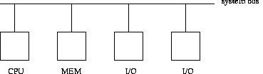
Hardware Overview
CPU
Executes the instructions of a program
Memory
Stores the program’s instructions and data
I/O devices
Allows the computer to interact with the outside world
Get information in and display output to the user
System Bus
Wires that connect the components together so that they can communicate

Slide 5
Memory
RAM (Random Access Memory)
Random Access Memory means that it takes the same amount of time to access an element regardless of where it is
Volatile
When you turn the power off you lose what is stored in it
Where your programs are stored when they are running
ROM (Read Only Memory)
Non-Volatile
When you turn the power off what is in it stays in it
System Bios are stored here
Not Hard Drive (That’s an I/O device)

Slide 6
I/O Devices
I/O = Input/Output
Allow you to interact with the computer and the computer to interact with the world
“Traditional:” Monitor, keyboard, mouse, speakers, ethernet port, camera
“Nontraditional:” robotic arm, credit card reader, wheels, infrared sensor

Slide 7
System Bus
The roads of the computer
Connect the components of the computer together so that they can communicate with each other
Just a bunch of wires
Nothing is stored in the bus it is just used to send values
System Bus can be logically broken down into 3 sub-buses
Control Bus: used to send control signals such as read or write
Address Bus: used to send the address that you want to read from or write to
Data Bus: used to send the data value
If control bus says to read then the data bus will contain the value read from memory at the value being sent on the address bus
If control bus says to do a write then the data bus will contain the value you want to write to memory

Slide 8
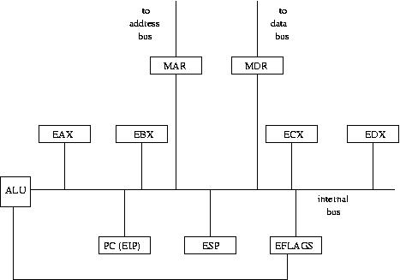
CPU Components

Slide 9
CPU Components
ALU: performs the operations (addition, subtraction, bitwise AND, etc)
Does not store anything, only does the calculations
Data Registers: small fast memory inside of the CPU that are used to store data and the results of the operations
PC: (Program Counter) Holds the address of the instruction currently being executed
Called EIP on Intel (Extended Instruction Pointer)
IR: (Instruction Register) Holds the instruction currently being executed
ESP: The stack pointer. It points to the top of the program’s stack

Slide 10
CPU Components
MAR (Memory Address register): register connecting CPU to the Address Bus
MDR (Memory Data register): register connecting CPU to the Data Bus
EFLAGS: stores various bits of data about the state of the program
Example: Was the result of the last operation 0? What mode we are in (user/kernel)
EFLAGS is going to be the only register that is not a word size. All of the other registers will be

Slide 11
CPU Cycle
The CPU is a fairly simple machine and simply repeats the following steps over and over again until you turn off the power
Fetch: the instruction pointed by the PC from memory and place it into the IR
Decode: the instruction and figure out what it does
Execute: the instruction inside of the ALU
Write: write the result of the instruction to a register or memory

Slide 12
CPU Speed
CPU Time: the amount of time the CPU spends executing code in your program
The time the CPU takes to finish a program can be described as follows
# of instructions in the program * clock cycles / instruction * time / clock cycle
Clock cycle speed is what you see reported on CPUs as their speed: 3.2 GHZ
This means that the computer completes 3.2 * 10⁹ cycles per second
Many times decreasing one parameter in the equation increases another
Wall Time: The amount of time it takes for your program to finish
This is normally larger than the CPU Time because we depend on other components (going to memory, going to disk, internet connection speed)
Hard to come up with an equation. Best thing to do is run the applications you are interested in on the computer and time it

Slide 13
Parallelism
One way to increase CPU is through parallelism, doing multiple operations at the same time
Pipelining: Breaking down a sequence into multiple stage and doing each stage to different things
Ideally you get an N times speed up when N is the number of stages
You are limited by the speed of the slowest stage so you’ll want to try and make sure each stage takes the same amount of time
You’ll get worse performance if the pipeline isn’t kept full
Example: Washing clothes. While one set of clothes is in the wash, another is in the dryer, and you are folding another set. So hopefully we’d get a 3X speedup
Can do the same thing with the CPU Cycle
Stages are Fetch, Decode, Execute, Write so we could look to get a 4X speed up

Slide 14
Parallelism
Pipelining is done in the hardware for you. The other way to get parallelism into your program to explicitly put it there
Two major paradigms
Message Passing: Processes explicitly send messages containing data to each other
Shared Memory: Processes share information implicitly through shared memory
Can be very challenging to do correctly and efficiently but it’s important to consider as datasets keep getting bigger
Ideally if you have N processors working on it you’ll get an N times speed up but often you’ll get less than that because of communications overhead and serialization points (areas that can’t be done in parallel)

